Slide 1
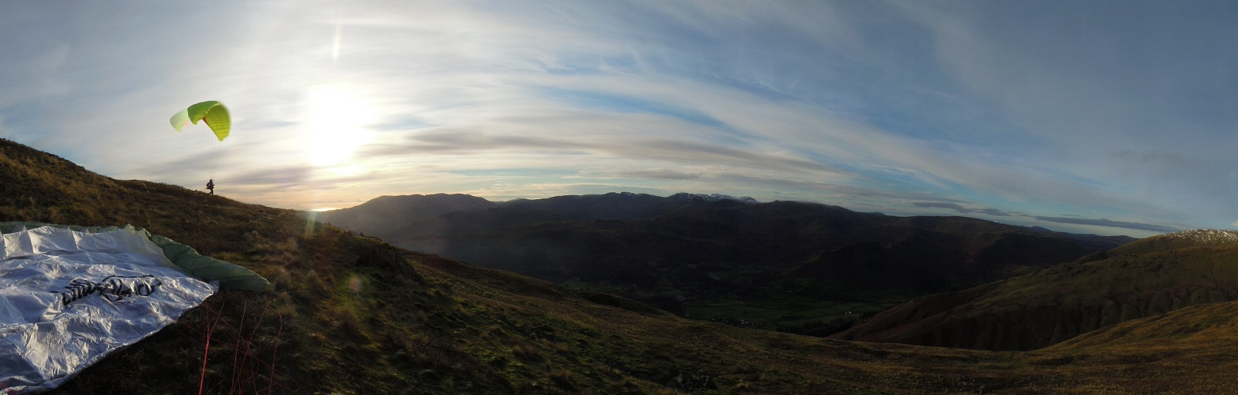

Programme
- Dales HG & PG Club -
6th February 2014
- VIDEO PROGRAMME -
A Lakeland Classic?
Up close and personal – coastal flying
Into the heart of the Dales
Surfing the Sierras – slides intro’/video1/2
Committee meetings – the inside story
www.xcflight.com

Slide 2
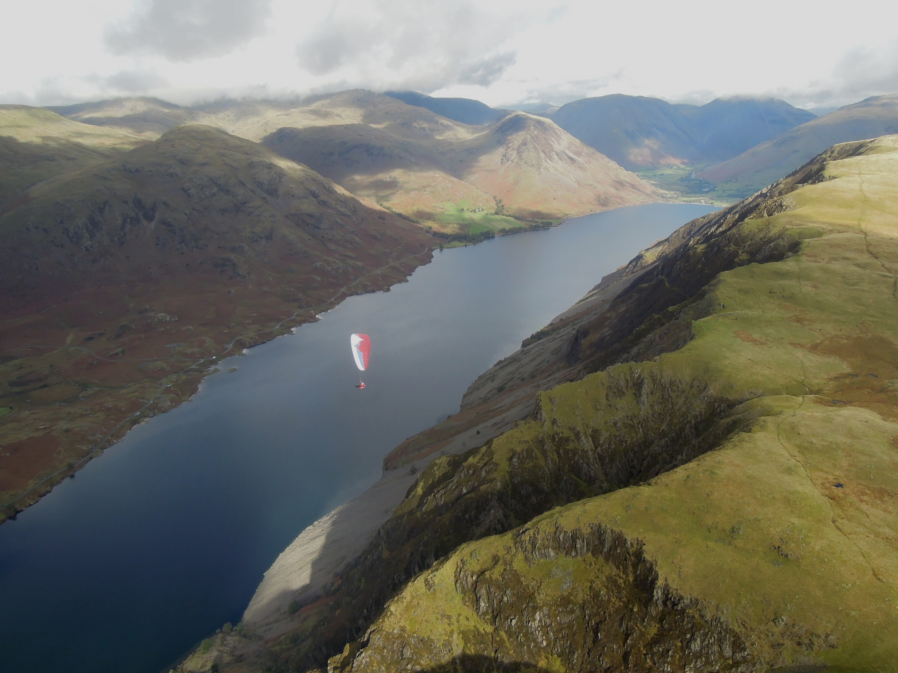
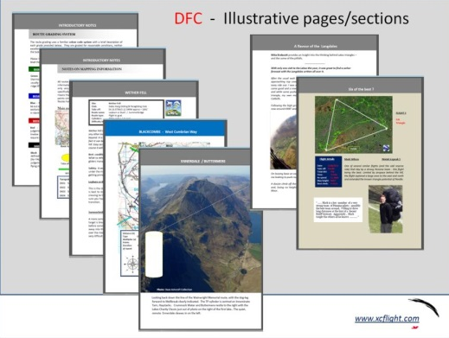
An personal insight into flying the Lake District
Topography
Flying conditions
Some typical routes

Slide 3
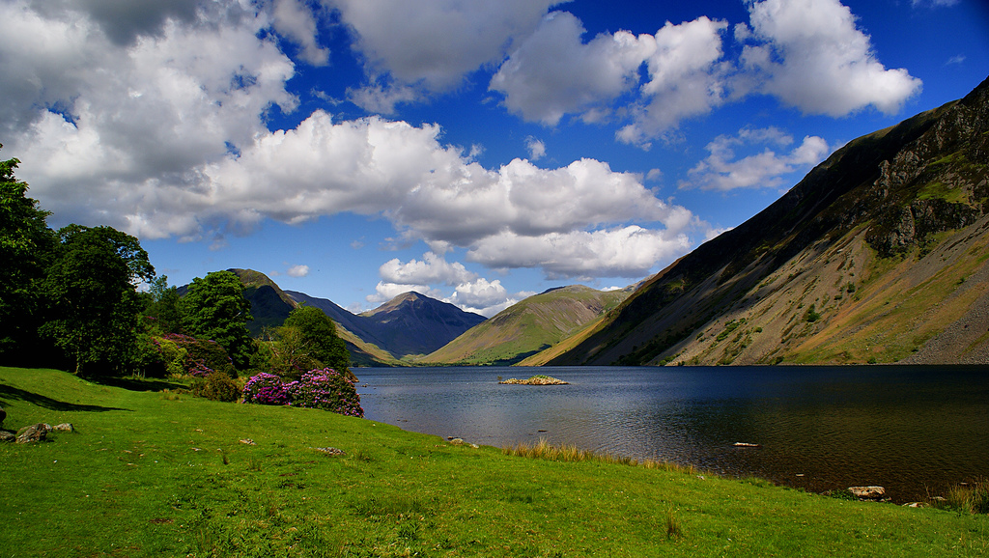
The Lake District – A selection of three mountain routes
Ennerdale/Wasdale/Eskdale
Wastwater Screes to Keswick
Barton/High Street/Kendal

Slide 4
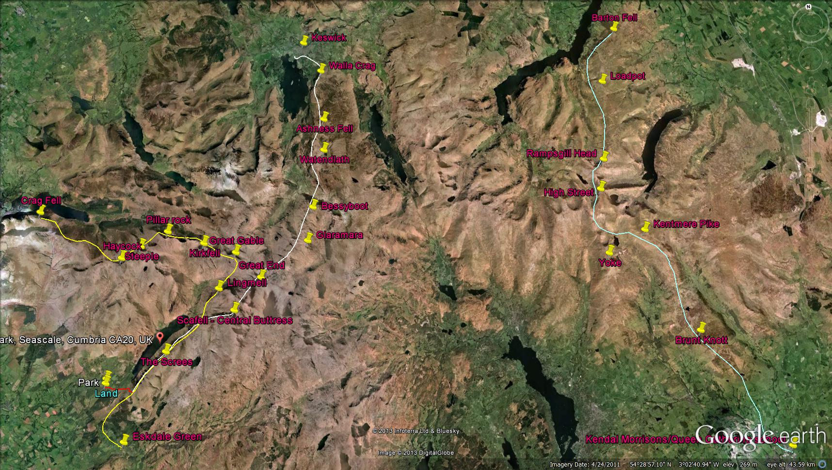
Barton to Kendal
Ennerdale/Wasdale/Eskdale
Wastwater Screes to Keswick

Slide 5
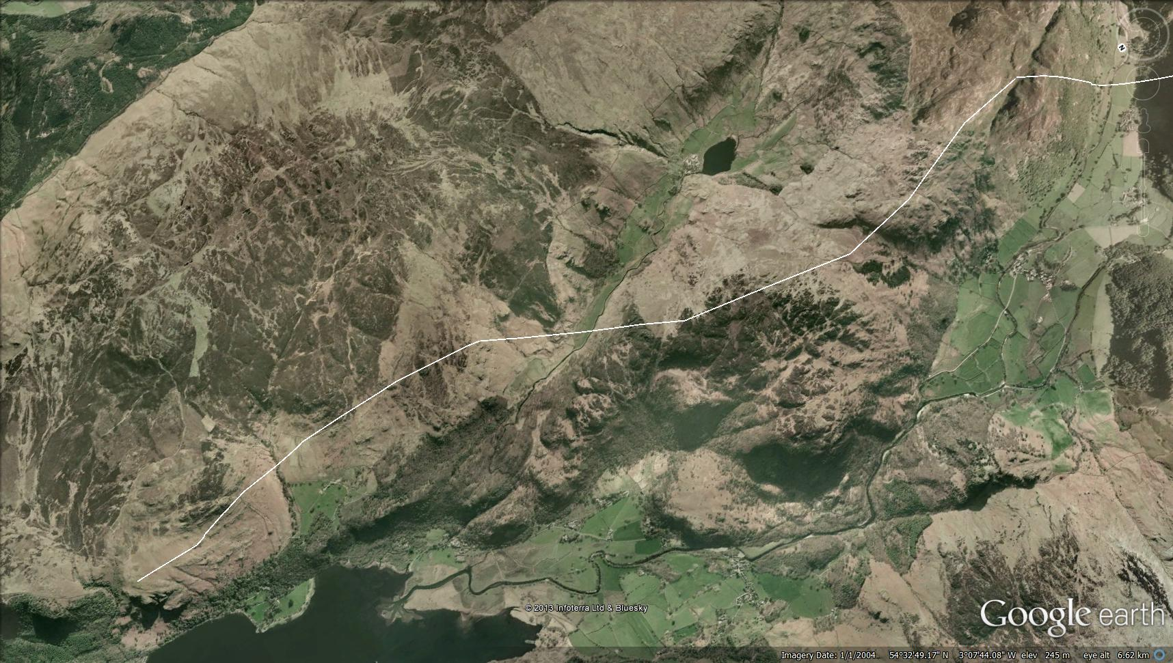
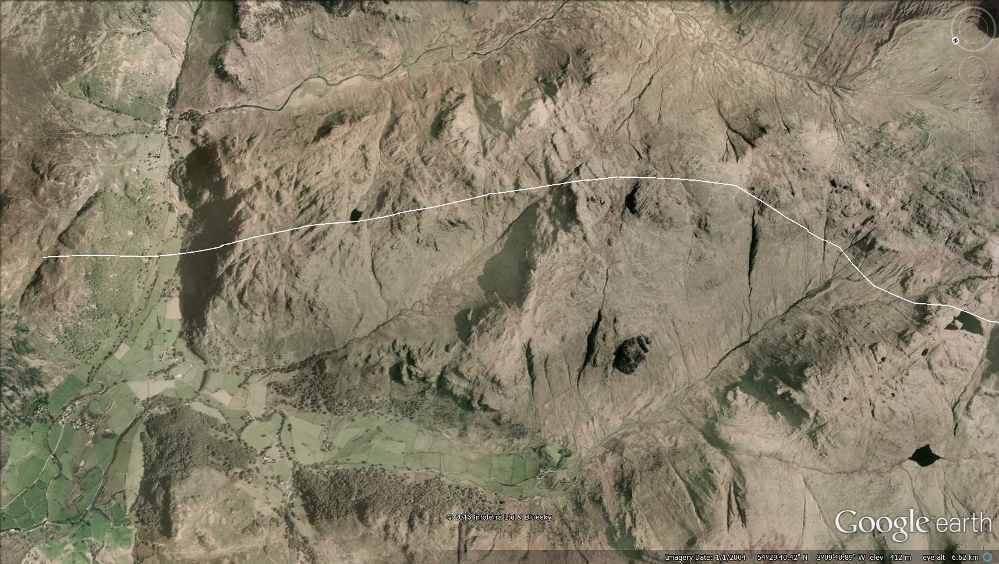
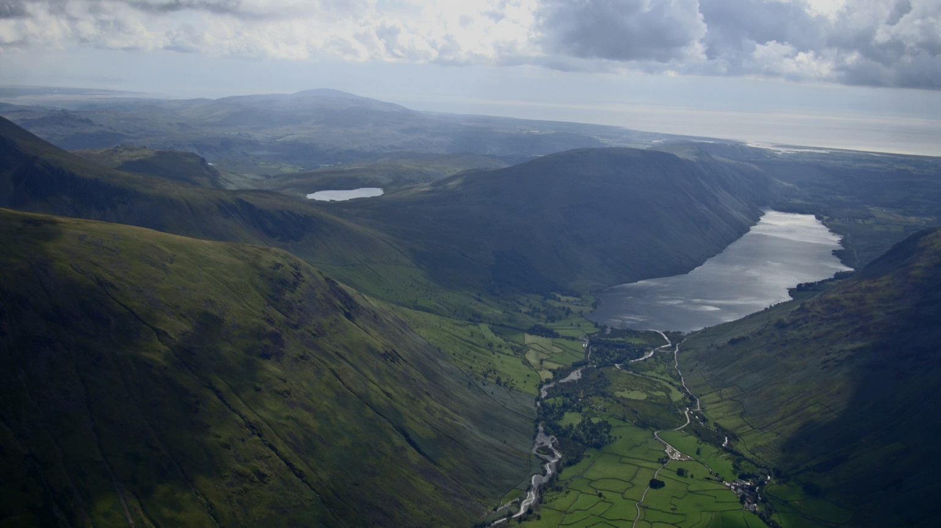
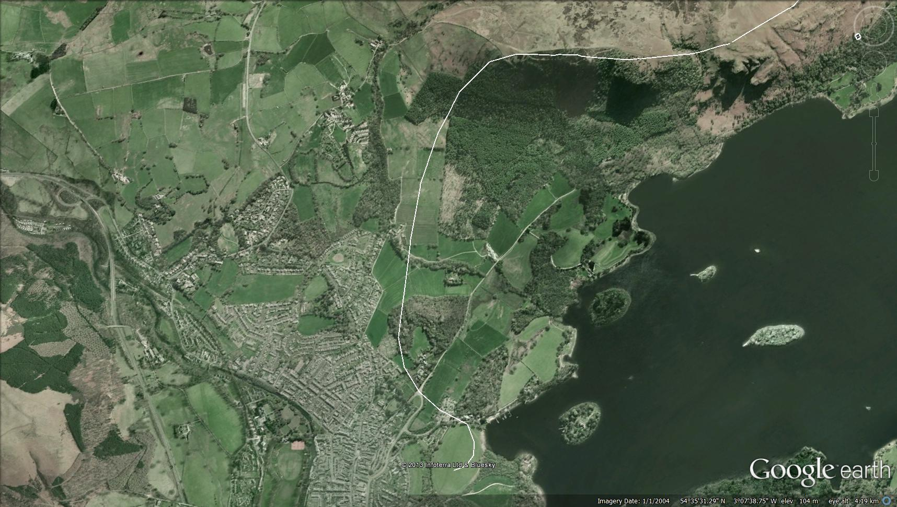
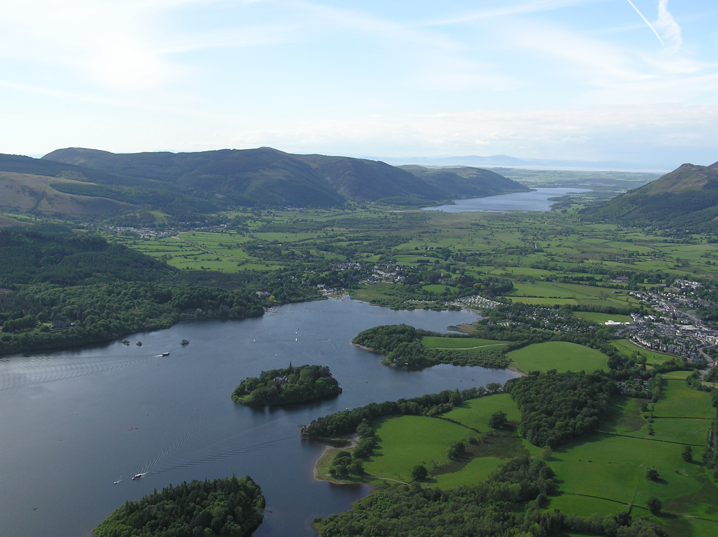
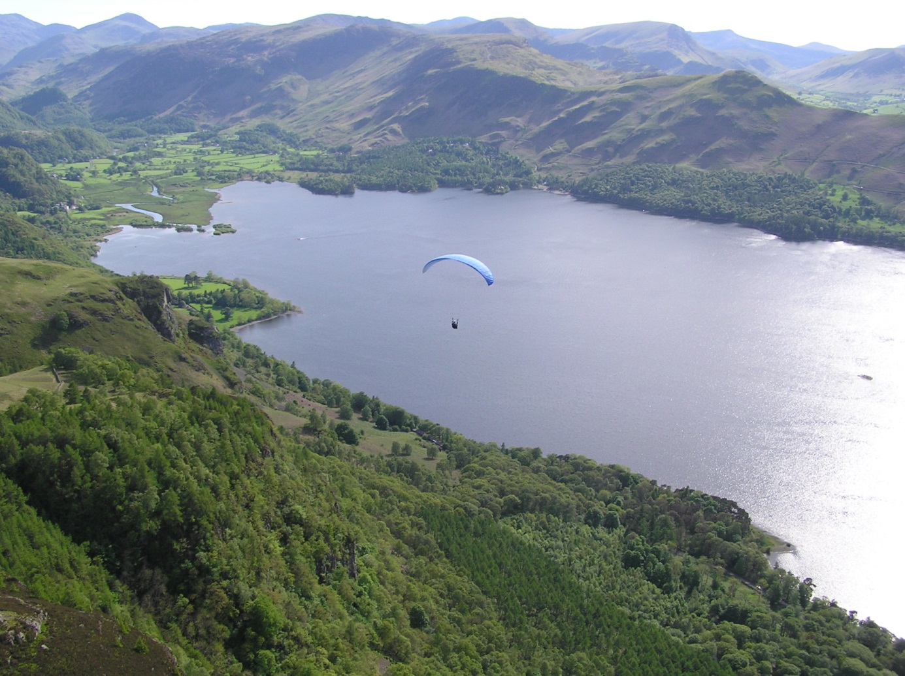
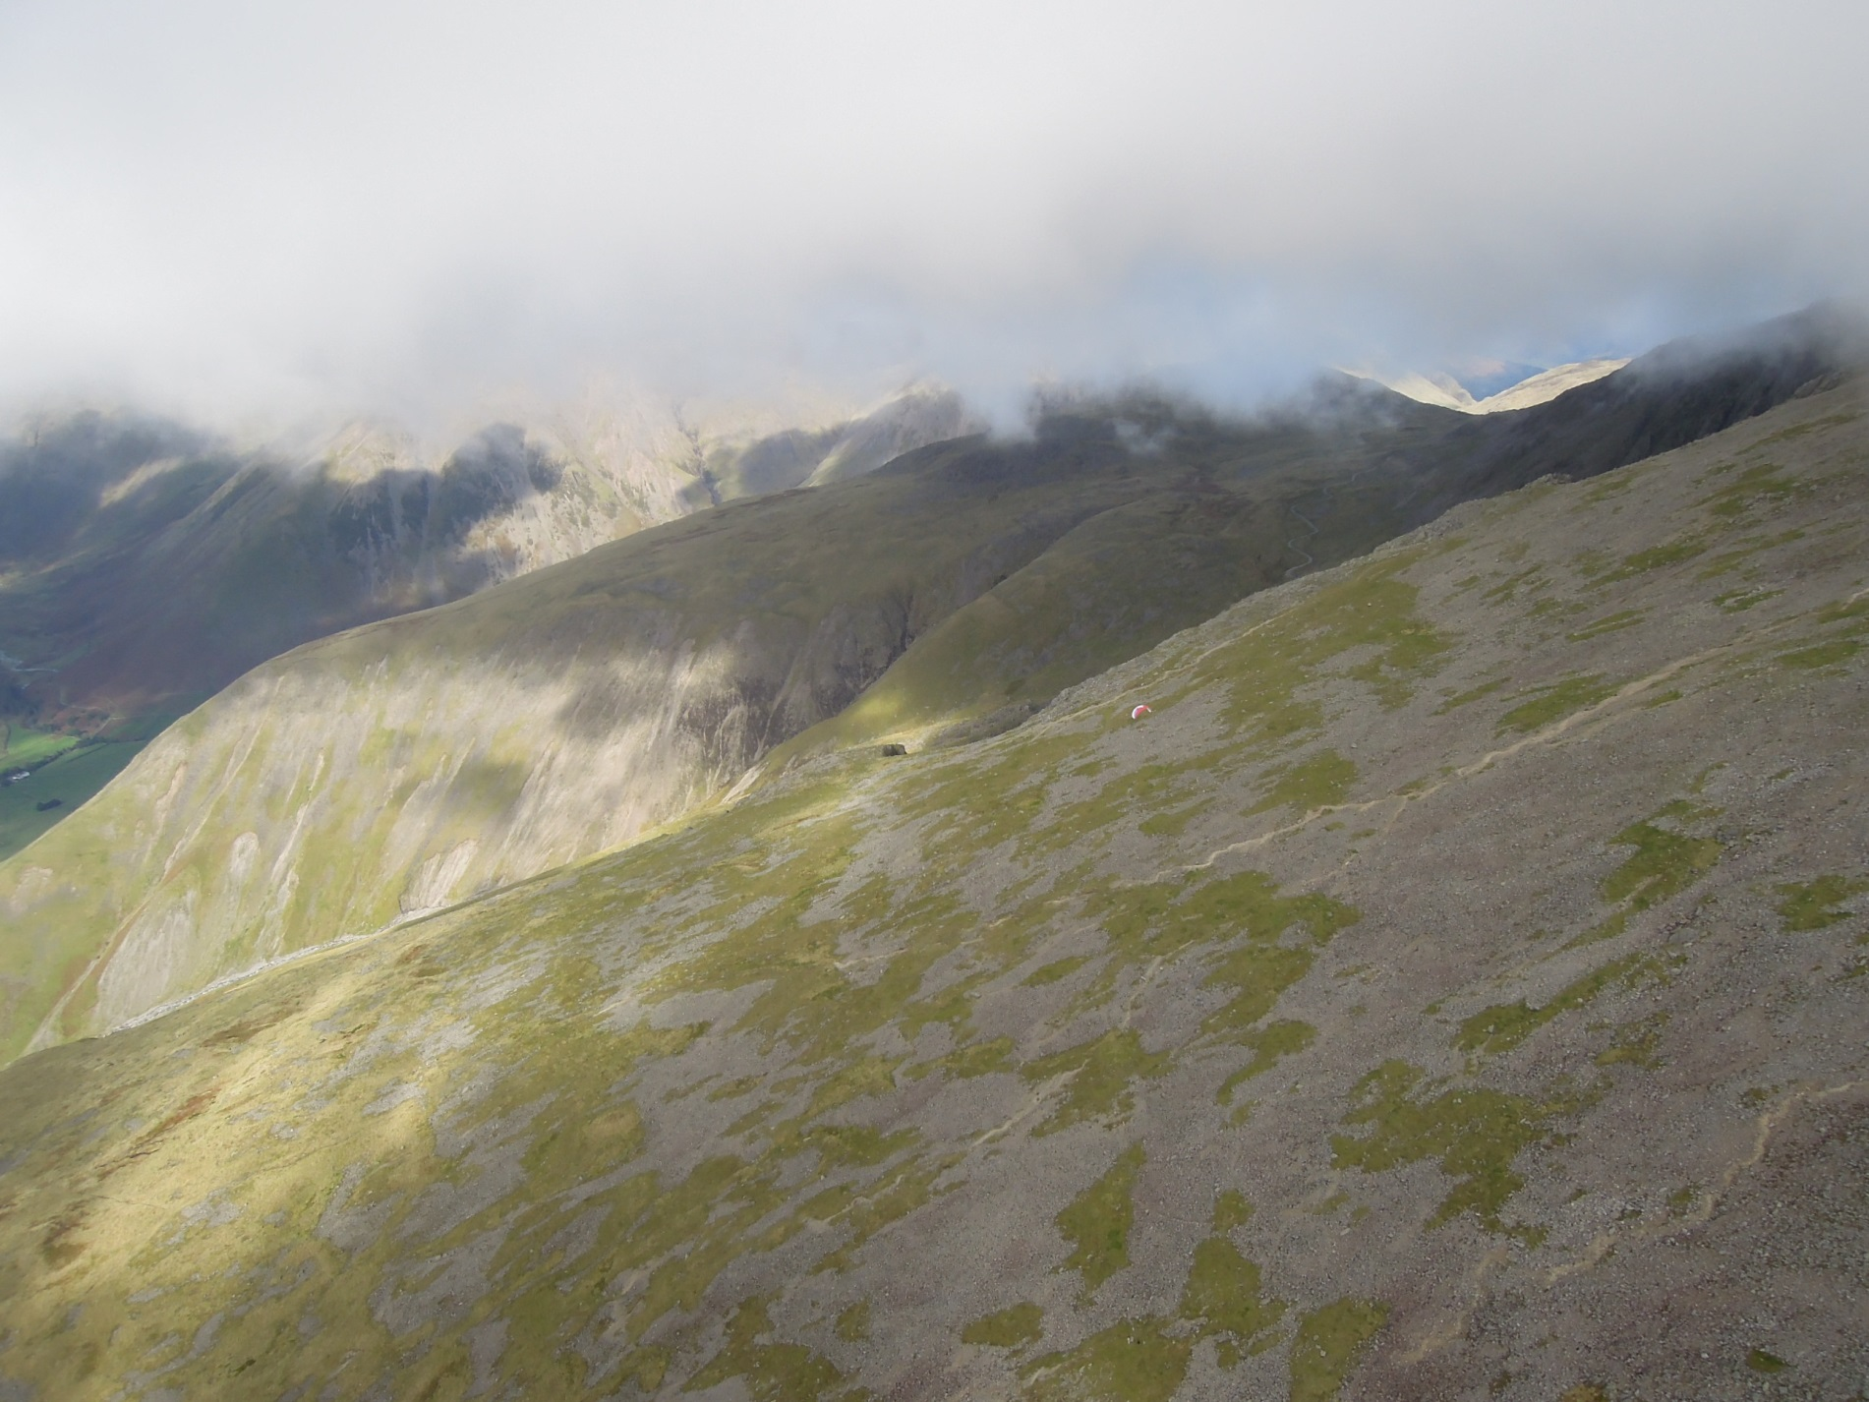
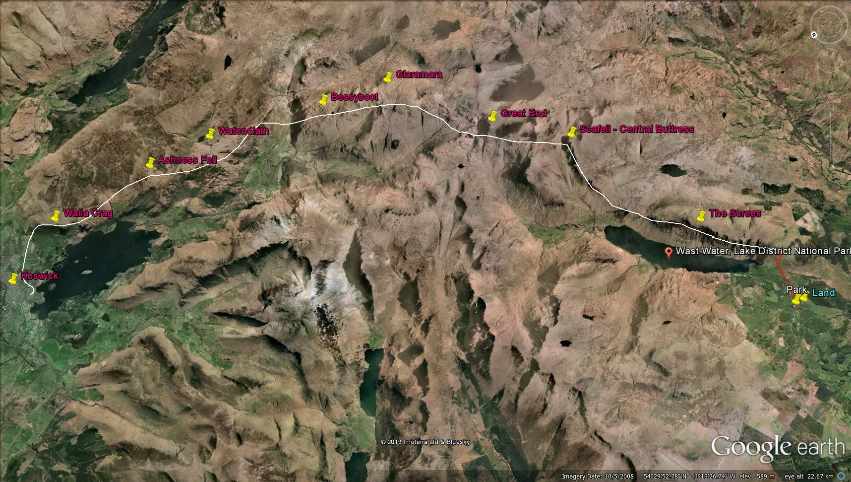
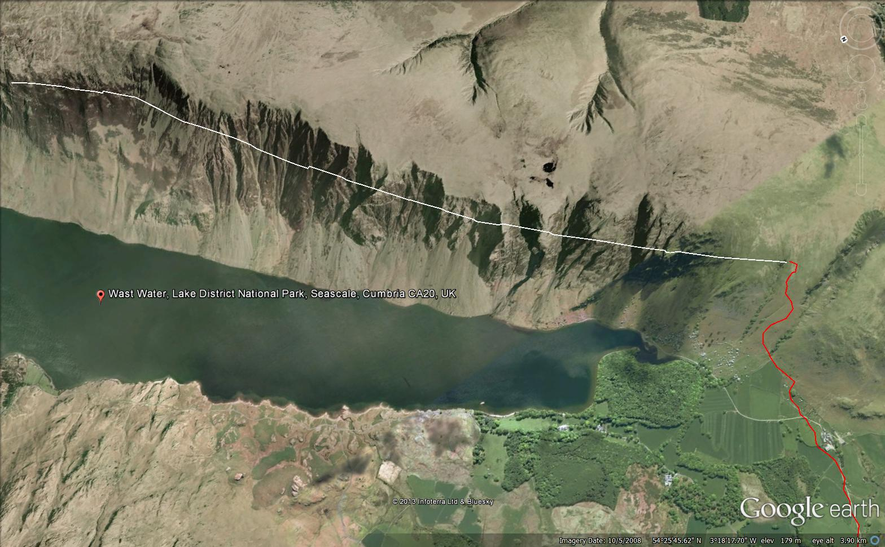
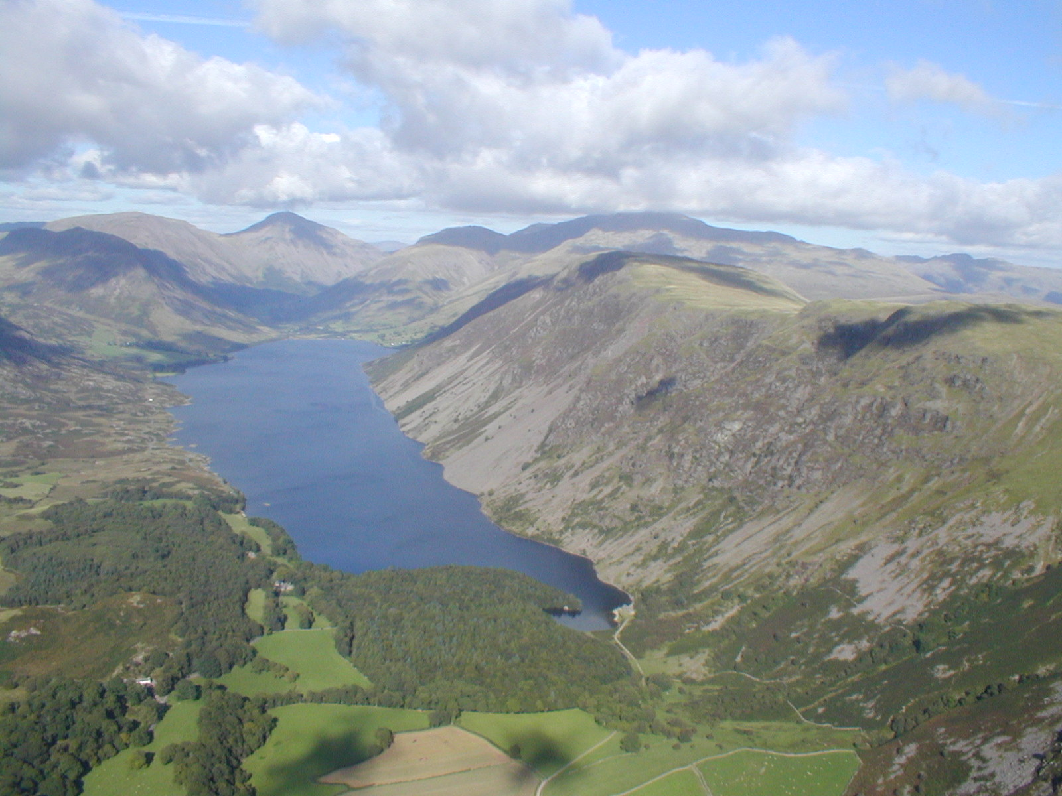
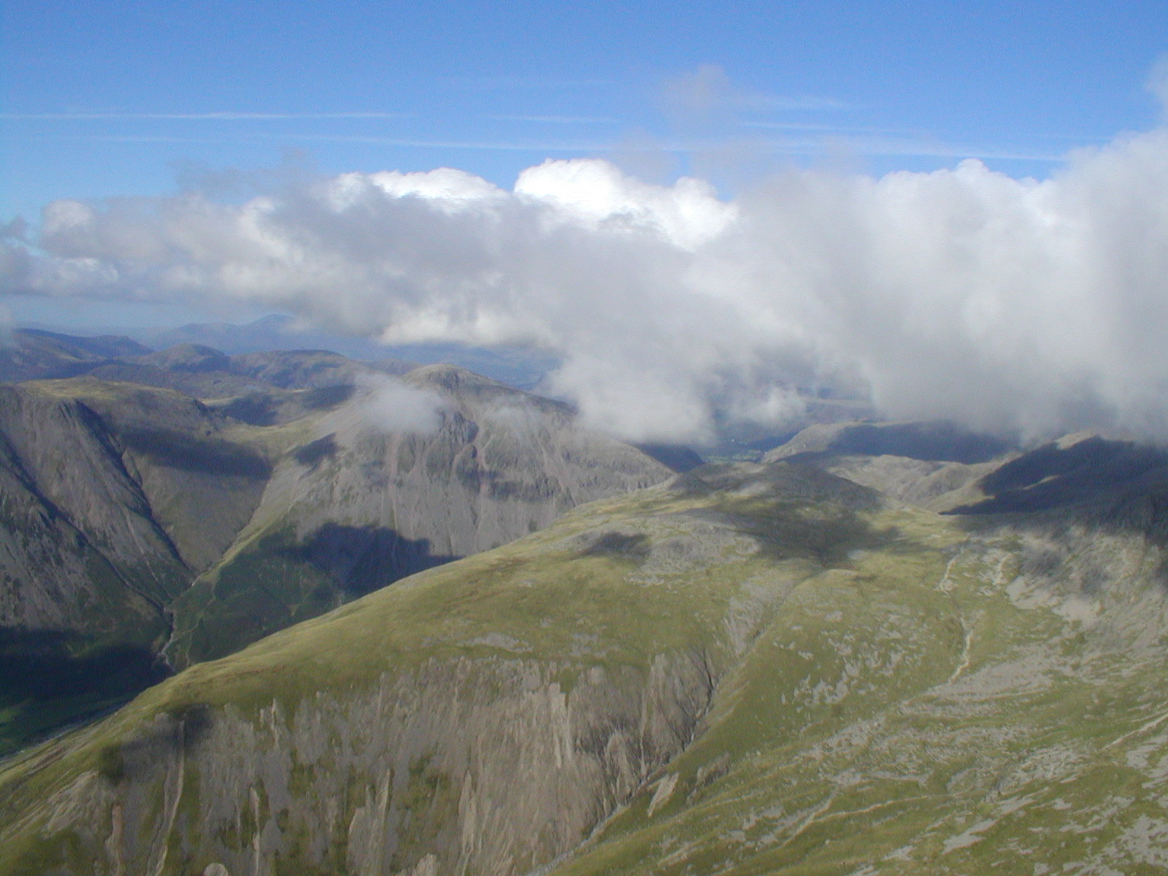
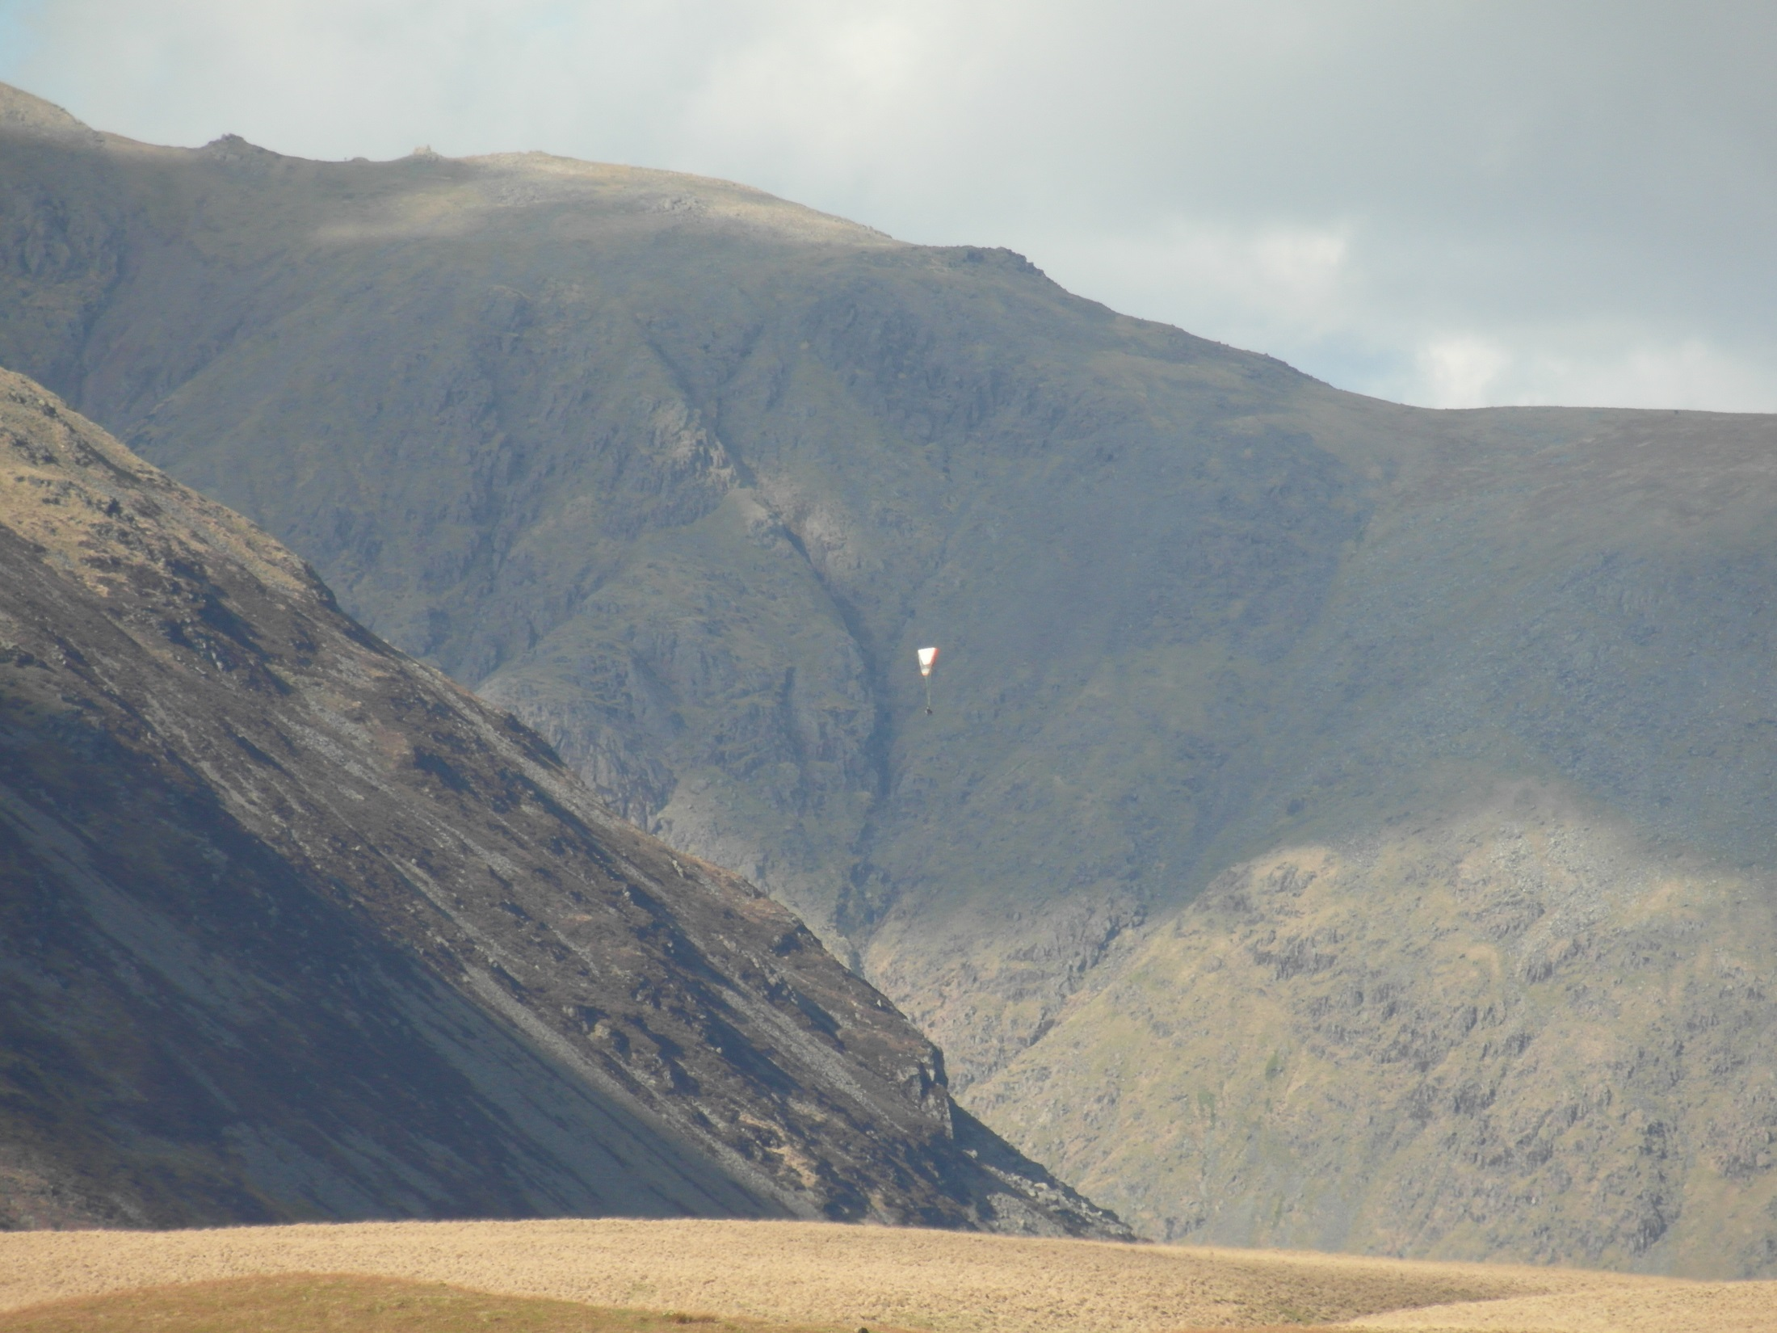
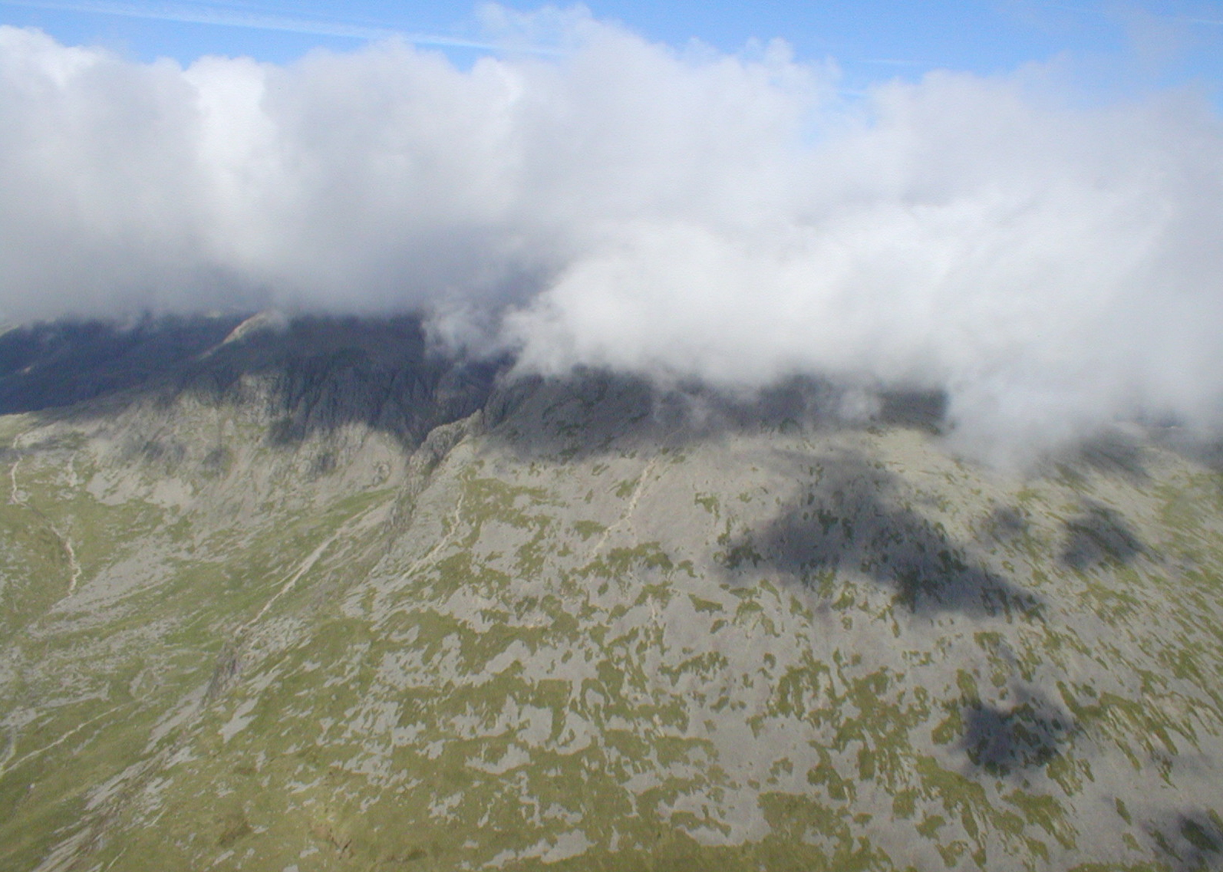
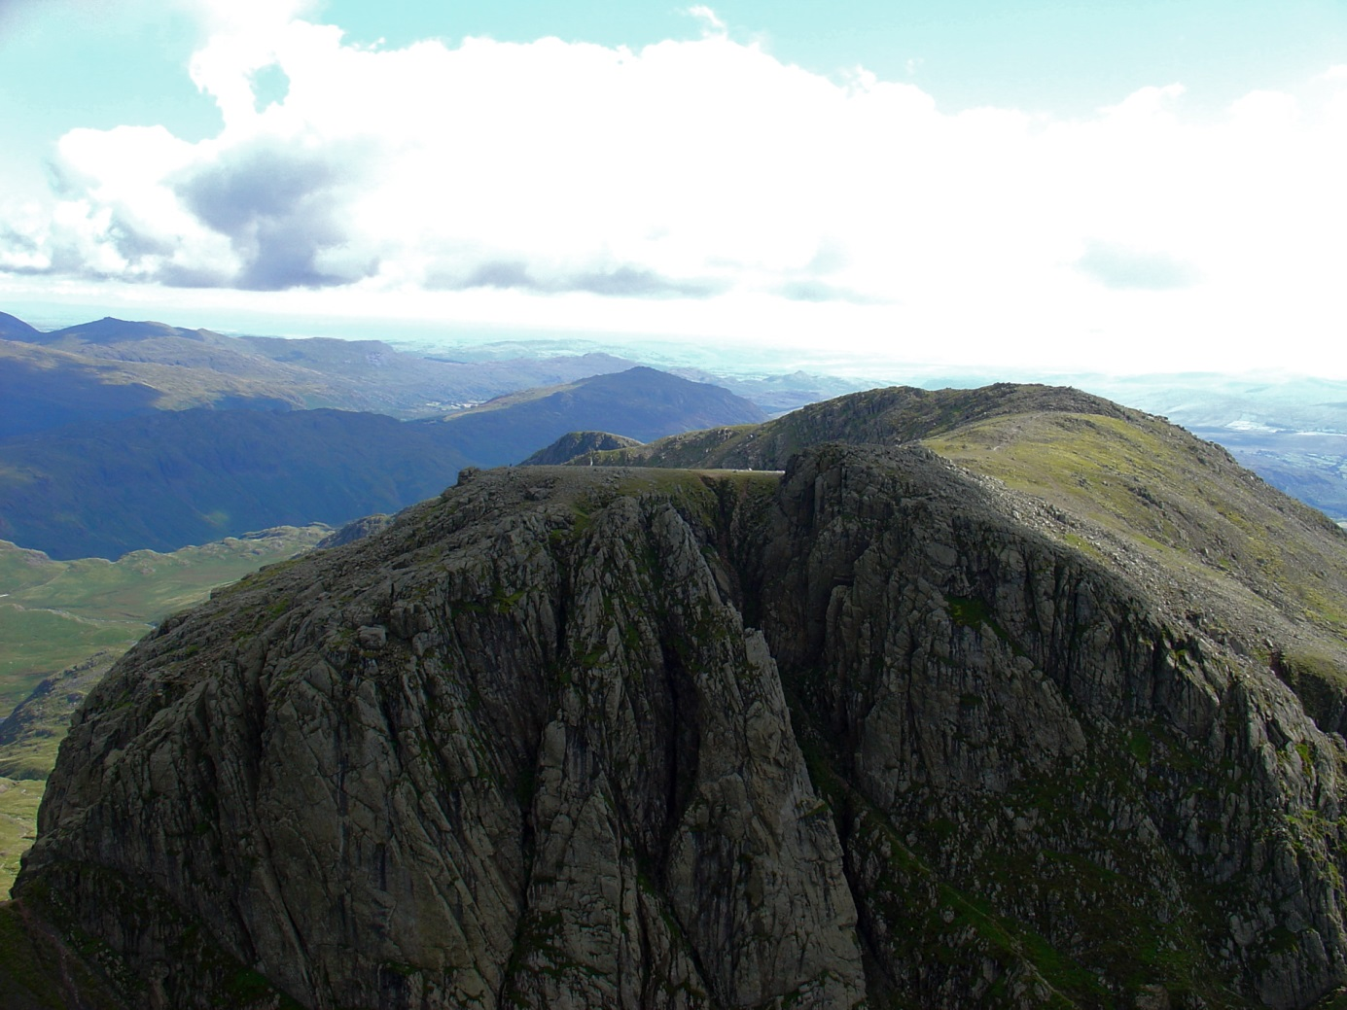
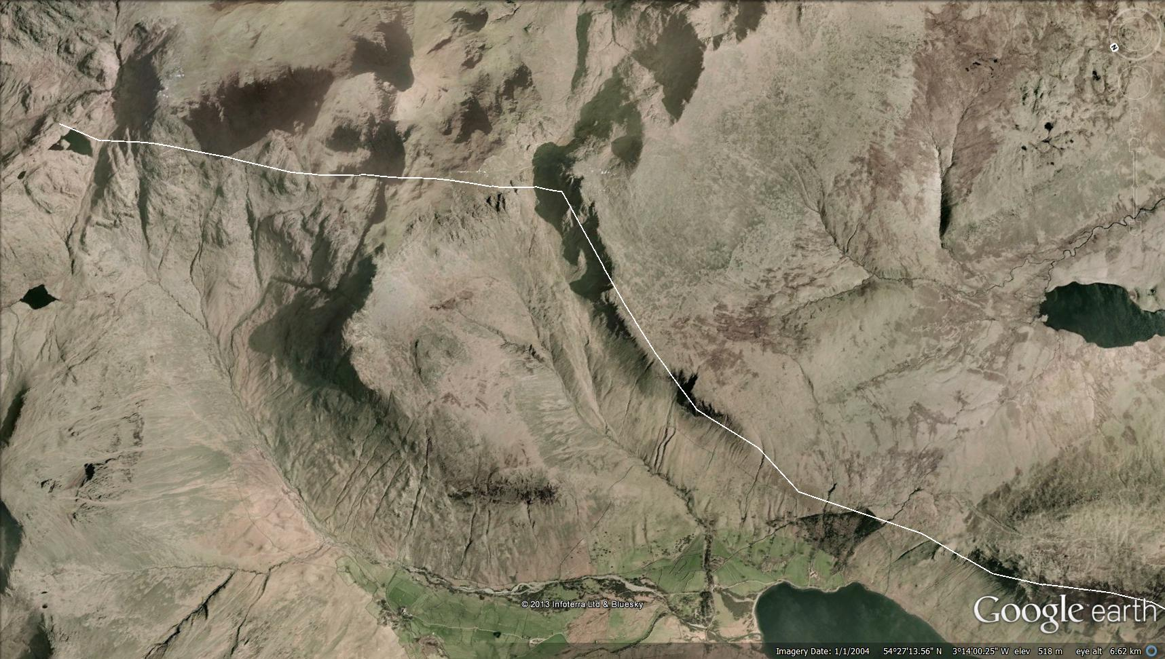
Screes/Scafell/Keswick ------------- route
Route end (Keswick)
VIDEO LINK

Slide 6
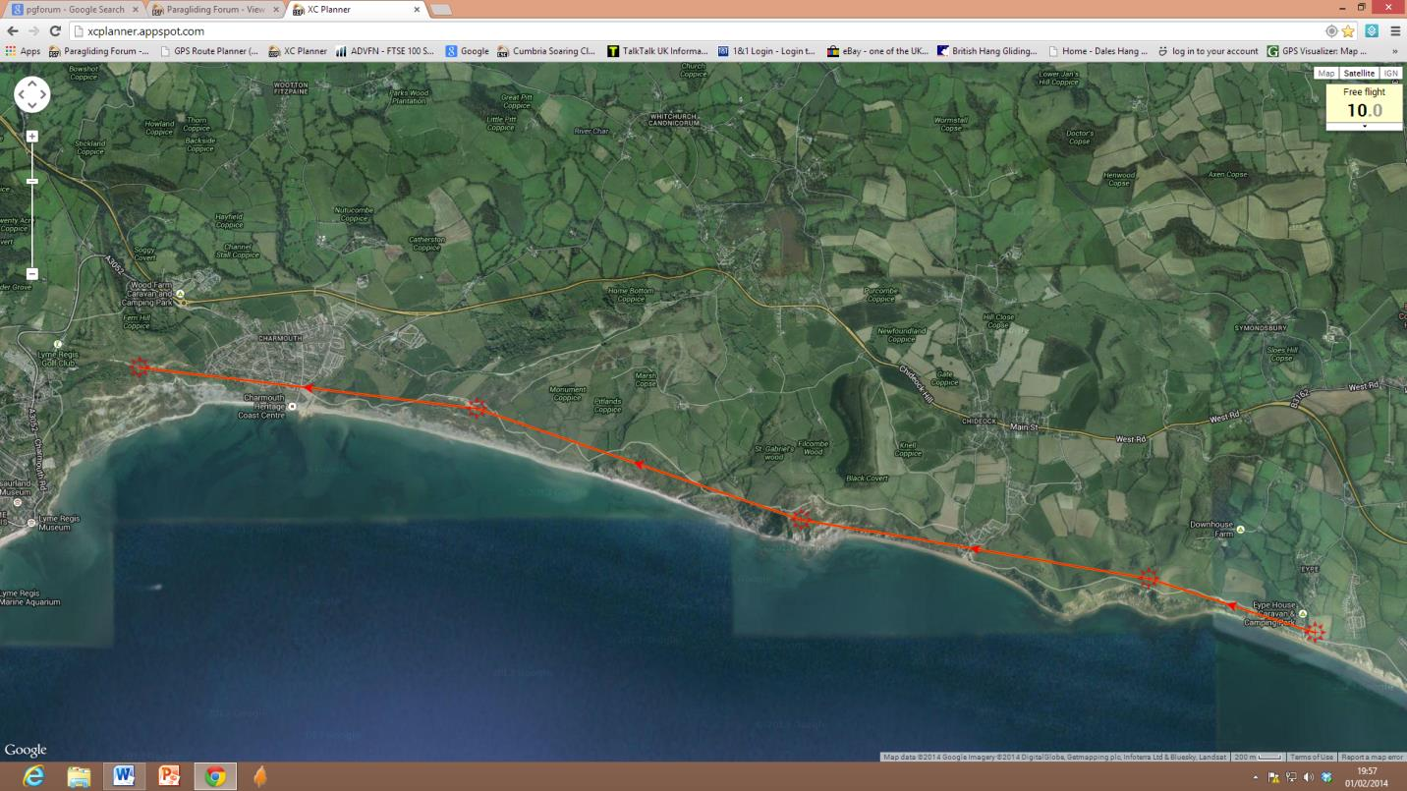
Eype to Charmouth
20k Out and Return coastal flight
VIDEO LINK
START/FINISH

Slide 7
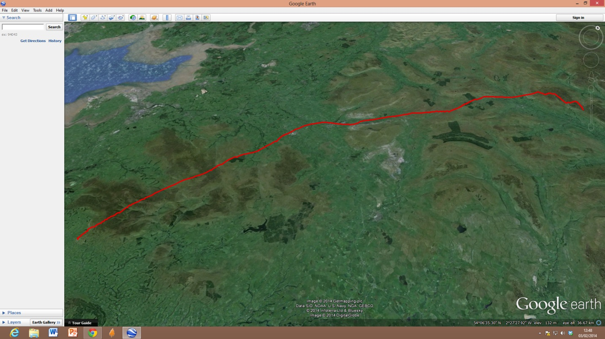
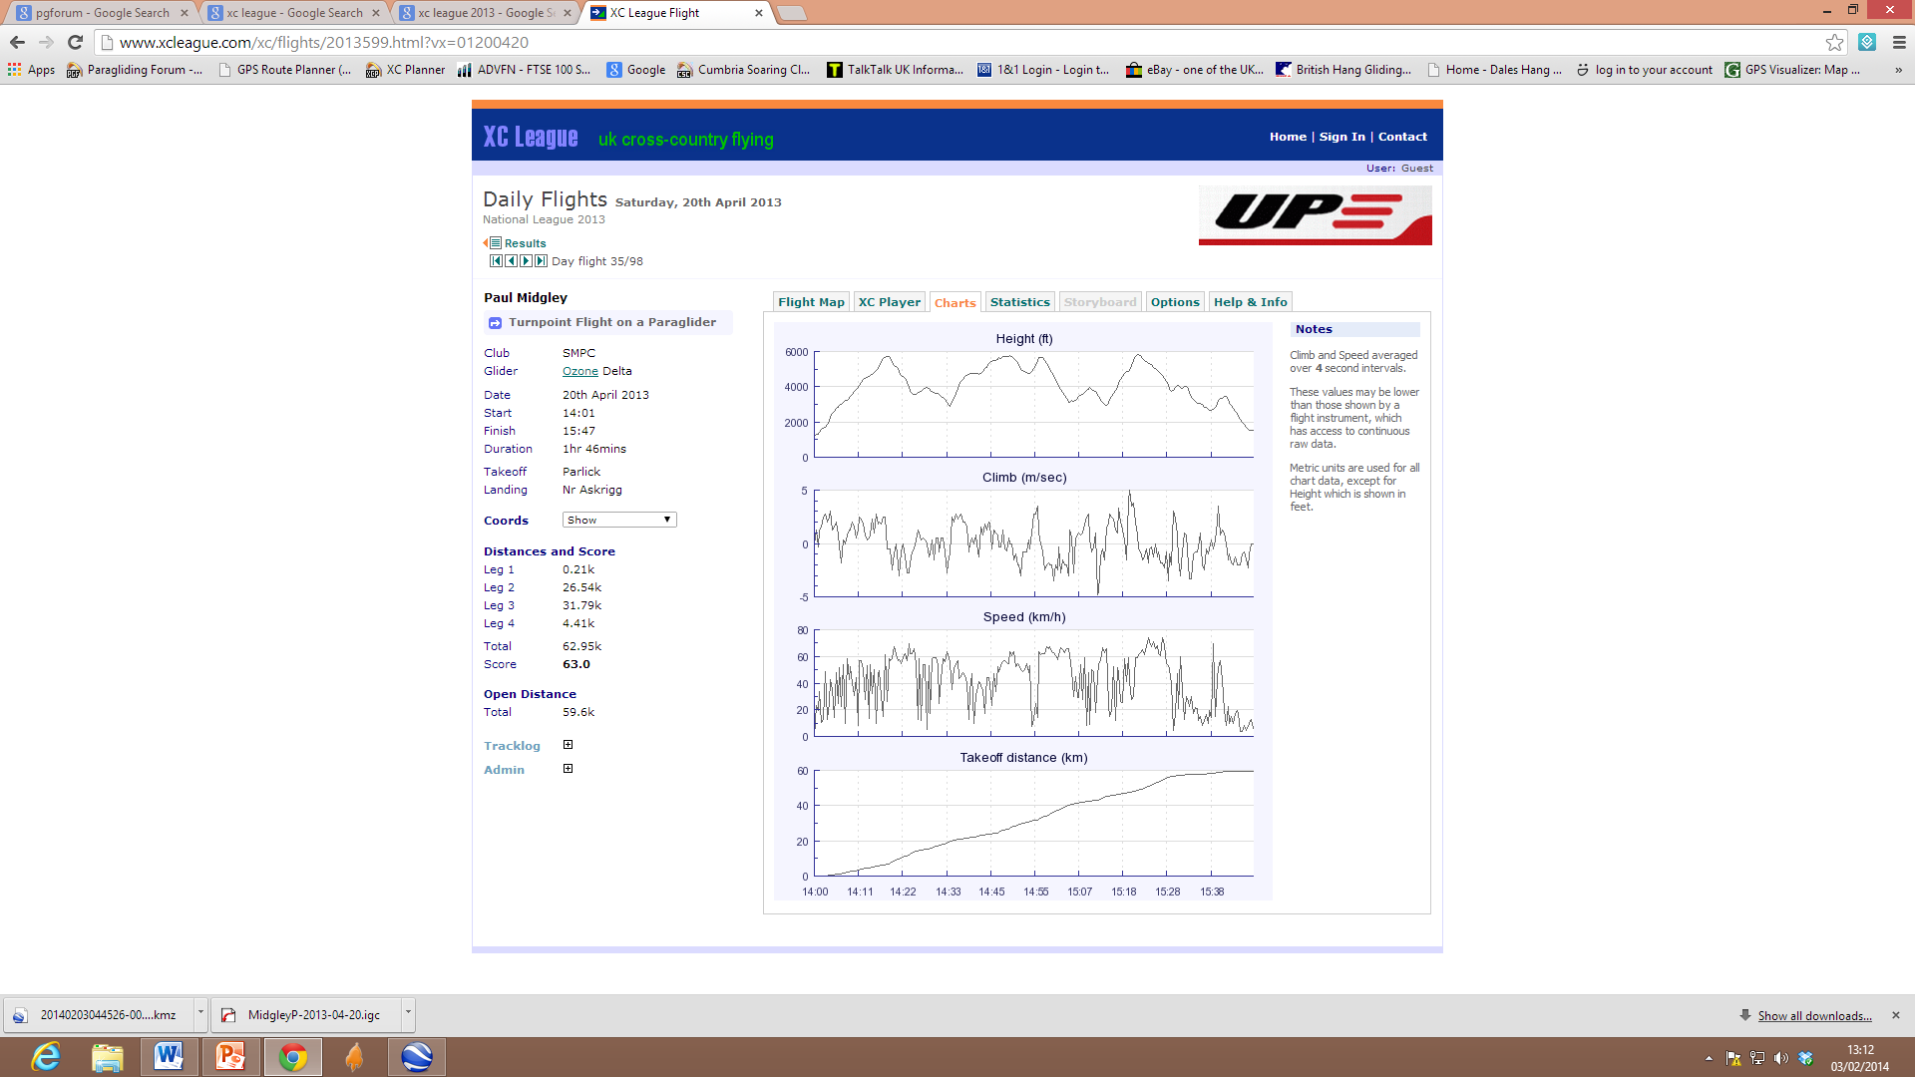
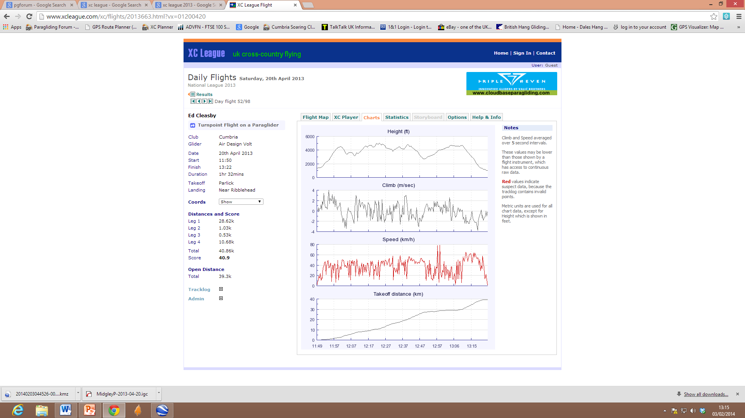
Spring XC into the Dales
VIDEO CLIP
Hawes
Parlick
20/4/2013 max height: 5850’ distance: 60k take off: 2pm landing:3:40pm

Slide 8
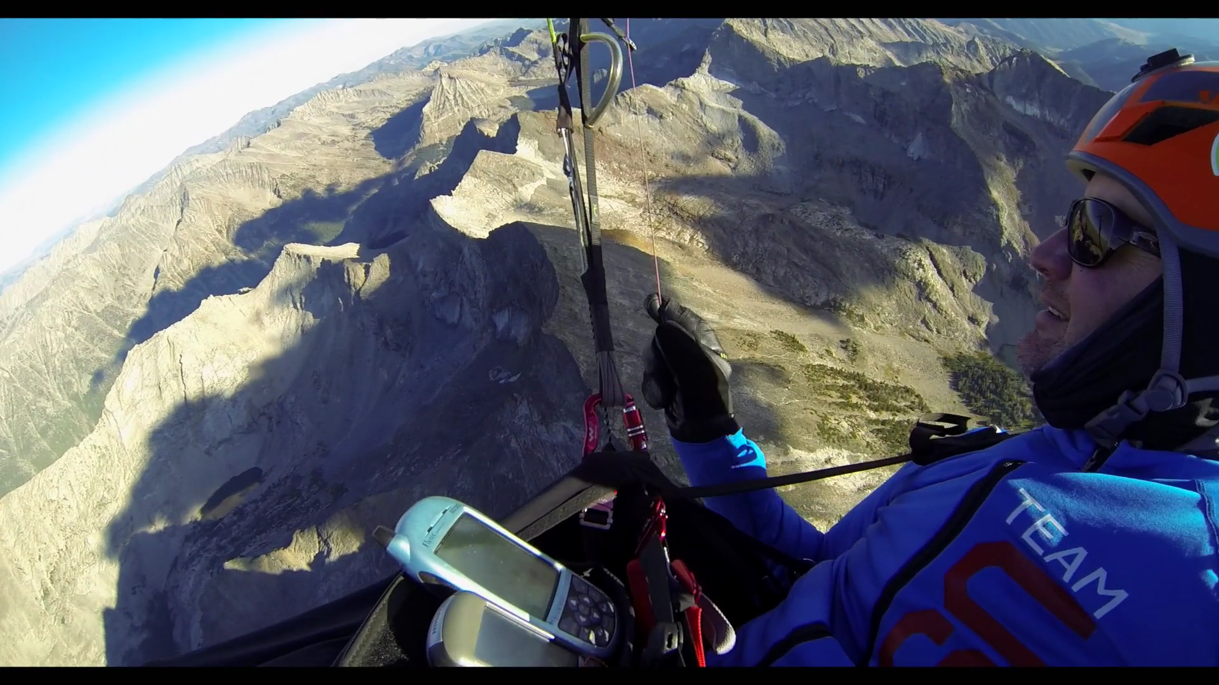
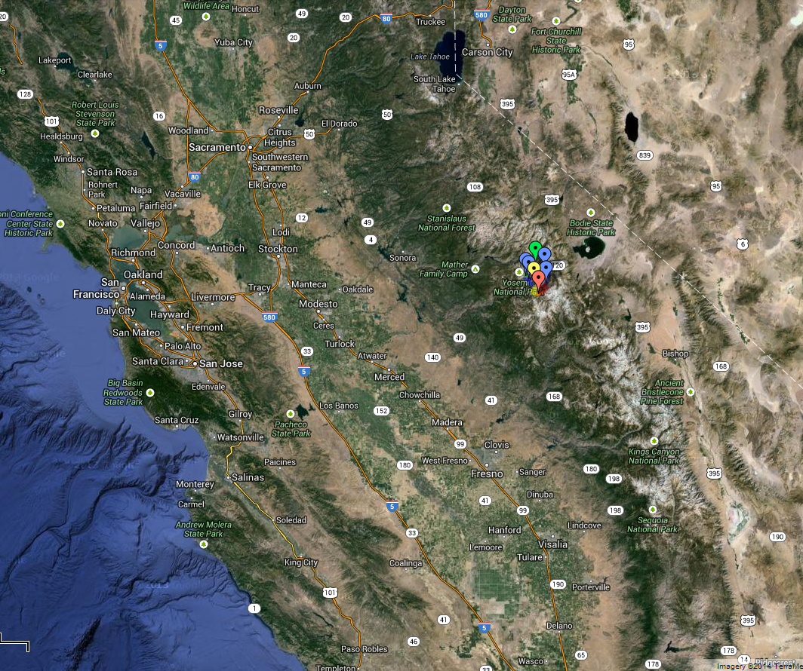
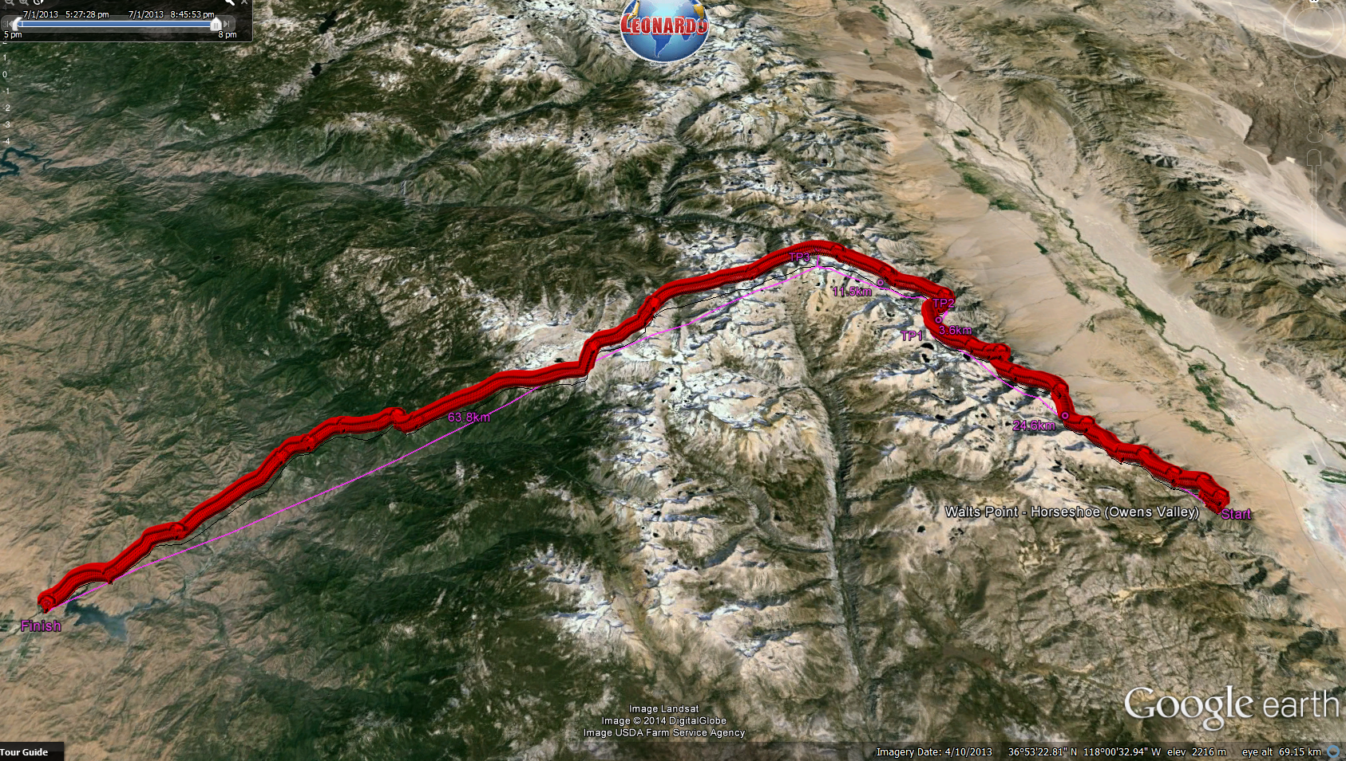
Surfing the Sierras
INTRO’ SLIDES
“Never compete with someone who has nothing to lose”.
Gracian
VIDEO CLIP (1)
VIDEO CLIP (2)

Slide 9
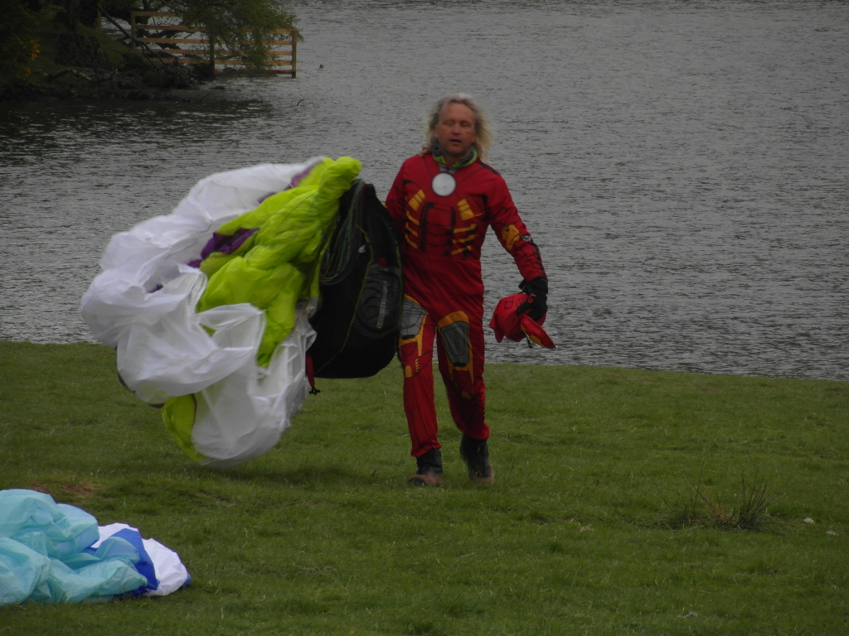
SO ………..
You want to be on the club committee?
Think it’s easy?
Can make sound judgements?
Understand the rules
Can keep calm and handle stress
WELL …….
Sometimes it can be difficult.
MEET ……….
VIDEO CLIP
‘IRONMAN’

Slide 10


www.xcflight.com

